Slide 1
Murang’a University of Technology Department of IT SIT404: CLIENT SERVER SYSTEMS Credit hours: 3 hours Course Notes – 2020/2021

Slide 2
Client/Server Application Components
A Client/Server application stand at a new threshold brought on by the exponential increase of low cost bandwidth on Wide Area Networks, for example, the Internet and CompuServe;
and shows a new generation of network enabled, multi-threaded desktop operating systems, for example, OS/2 Warp Connect and Windows 95.
This new threshold marks the beginning of a transition from Ethernet Client/Server to intergalactic Client/Server that will result in the irrelevance of proximity. The center of gravity is shifting from single server, two tiers;

Slide 3
Client/Server Application Components cont’d
LAN based departmental Client/Server to a post scarcity form of Client/Server where every machine on the global information highway can be both a client and a server.
When it comes to intergalactic Client/Server applications, the imagination is at the controls.
The promise of high bandwidth at very low cost has conjured visions of an information highway that turns into the world’s largest shopping mall.
The predominant vision is that of an electronic bazaar of planetary proportions replete with boutiques, department stores, bookstores, brokerage services, banks, and travel agencies.

Slide 4
Client/Server Application Components cont’d
Like a Club Med, the mall will issue its own electronic currency to facilitate round the clock shopping and business to business transactions. Electronic agents of all kinds will be roaming around the network looking for bargains and conducting negotiations with other agents. Billions of electronic business transactions will be generated on a daily basis. Massive amounts of multimedia data will also be generated, moved, and stored on the network.

Slide 5
TECHNOLOGIES FOR CLIENT/SERVER APPLICATION
Some key technologies are needed at the Client/Server application level to make all this happen, including:
Rich transaction processing:
In addition to supporting the venerable flat transaction, the new environment requires nested transactions that can span across multiple servers, long-lived transactions that execute over long periods of time as they travel from server to server, and queued transactions that can be used in secure business-to-business dealings. Most nodes on the network should be able to participate in a secured transaction; super server nodes will handle the massive transaction loads.

Slide 6
TECHNOLOGIES FOR CLIENT/SERVER APPLICATION cont’d
Roaming agents:
The new environment will be populated with electronic agents of all types. Consumers will have personal agents that look after their interests; businesses will deploy agents to sell their wares on the network; and sniffer agents will be sitting on the network, at all times, collecting information to do system management or simply looking for trends. Agent technology includes cross-platform scripting engines, workflow, and Java-like mobile code environments that allow agents to live on any machine on the network.

Slide 7
TECHNOLOGIES FOR CLIENT/SERVER APPLICATION cont’d
Rich data management:
This includes active multimedia compound documents that you can move, store, view, and edit in-place anywhere on the network. Again, most nodes on the network should provide compound document technology — for example, OLE or OpenDoc – for doing mobile document management. Of course, this environment must also be able to support existing record-based structured data including SQL databases.

Slide 8
TECHNOLOGIES FOR CLIENT/SERVER APPLICATION cont’d
Intelligent self-managing entities: With the introduction of new multi-threaded, high-volume, network-ready desktop operating systems; we anticipate a world where millions of machines can be both clients and servers. However, we can’t afford to ship a system administrator with every $99 operating system. To avoid
doing this, we need distributed software that knows how to manage and configure itself and protect itself against threats.

Slide 9
TECHNOLOGIES FOR CLIENT/SERVER APPLICATION cont’d
Intelligent middleware: The distributed environment must provide the semblance of a single-system-image across potentially millions of hybrid Client/Server machines.
The middleware must create this Houdini-sized illusion by making all servers on the global network appear to behave like a single computer system. Users and programs should be able to dynamically join and leave the network, and then discover each other. You should be able to use the same naming conventions to locate any resource on the network

Slide 10
SERVICE OF A CLIENT/SERVER APPLICATION
In this section, the discussion is about most widely used five types of Client/Server applications. In no way is this meant to cover all Client/Server applications available today. The truth, there is no agreement within the computer industry as to what constitutes Client/Server and therefore, what one expect or vendor may claim to be Client/Server may not necessarily fit the definition of others
In general, Client/Server is a system. It is not just hardware or software. It is not necessarily a program that comes in a box to be installed onto your computer’s hard drive (although many software manufacturers are seeing the potential market for Client/Server products, and therefore are anxious to develop and sell such programs). Client/Server is a conglomeration of computer equipment, infrastructure, and software programs working together to accomplish computing tasks which enable their users to be more efficient and productive. Client/Server applications can be distinguished by the nature of the service or type of solutions they provide.

Slide 11
SERVICE OF A CLIENT/SERVER APPLICATION cont’d
Among them five common types of solutions are as given
below.
• File sharing.
• Database centered systems.
• Groupware.
• Transactional processing.
• Distributed objects.

Slide 12
SERVICE OF A CLIENT/SERVER APPLICATION cont’d
File sharing: File sharing is Client/Server in its most primitive form. It is the earliest form of computing over a network. Some purists would deny that file sharing is Client/Server technology. In file sharing, a client computer simply sends a request for a file or records to a file server. The server, in turn, searches its database and fills the request. Usually, in a file sharing environment, the users of the information have little need for control over the data or rarely have to make modifications to the files or records. File sharing is ideal for organizations that
have shared repositories of documents, images, large data objects, read-only files,
etc.

Slide 13
SERVICE OF A CLIENT/SERVER APPLICATION cont’d
Database centered systems: The most common use of Client/Server technology is to provide access to a commonly shared database to users (clients) on a network. This differs from simple file sharing in that a database centered system not only allows clients to request data and data-related services, but it also enables them to modify the information on file in the database. In such systems, the database server not only houses the database itself; it helps to manage the data by providing secured access and access by multiple users at the same time. Database-centered systems utilize SQL, a simple computer language which enables data request and fulfillment messages to be understood by both clients and servers. Database-centered Client/Server applications generally fall into one of two categories:
Decision-Support Systems (DSS) or
Online Transaction Processing (OLTP).

Slide 14
SERVICE OF A CLIENT/SERVER APPLICATION cont’d
Both provide data on request but differ in the kinds of information needs they fulfill.
(i) Decision-support systems (DSS): Decision-Support Systems (DSS) are used when clients on the system frequently do analysis of the data or use the data to create reports and other documents. DSS provides a “snapshot” of data at aparticular point in time. Typically, DSS might be utilized for a library catalog,
WWW pages, or patient records in a doctor’s office.
(ii) Online transaction processing: Online Transaction Processing (OLTP) provides current, up-to-the-minute information reflecting changes and continuous updates. Users of an OLTP system typically require mission-critical applications that perform data access functions and other transactions with a one to two seconds response time. Airline reservations systems, point-of-sale tracking systems (i.e., “cash registers” in large department stores or super markets), and a stockbroker’s workstation are OLTP applications

Slide 15
SERVICE OF A CLIENT/SERVER APPLICATION cont’d
Structured Query Language (SQL): SQL, pronounced “sequel”, stands for Structured Query Language. It is a simple set of commands which allows users to control sets of data. Originally developed by IBM, it is now the predominant database language of mainframes, minicomputers, and LAN servers. It tells the server what data the client is looking for, retrieves it, and then figures out how to get it back to the client. SQL has become the industry standard for creating shared databases having received the “stamp of approval” from the ISO and ANSI. That’s important since prior to this, there was no one commonly agreed upon way to create Client/Server database applications. With standardization, SQL has become more universal which makes it easier to set up Client/Server database systems in multi-platform/multi-NOS environments

Slide 16
SERVICE OF A CLIENT/SERVER APPLICATION cont’d
Groupware
Groupware brings together five basic technologies multimedia document management, workflow, scheduling, conferencing, and electronic mail, in order to facilitate work activities. One author defines groupware as “software that supports creation, flow, and tracking of non-structured information in direct support of collaborative group activity.” Groupware removes control over documents from the server and distributes it over a network, thus enabling collaboration on specific tasks and projects. The collaborative activity is virtually concurrent meaning that clients on the network, wherever they may be, can contribute, produce, and modify documents, and in the end, using the management and tracking features, synchronizes everything and produces a collective group product.

Slide 17
SERVICE OF A CLIENT/SERVER APPLICATION cont’d
Multimedia Document Managements (MMDM)
With groupware, clients can have access to documents and images as needed. Multimedia document management (MMDM) allows them to take those documents and modify them. The modifications can take place in real time with several clients making changes and modifications simultaneously, or they can be modified, stored on the server for review or future action by other clients. MMDM is, in essence, an electronic filing cabinet that holds documents in the form of text, images, graphics, voice clips, video, and other media.

Slide 18
SERVICE OF A CLIENT/SERVER APPLICATION cont’d
Workflow
Workflow refers to technologies which automatically route events (work) from one program to the next in a Client/Server groupware environment. It determines what needs to be done to complete a task or project, then merges, transforms, and routes the work item through the collaborative process. Workflow is especially applicable to routine tasks such as processing insurance claims or income tax return preparation.
Scheduling (or Calendaring)
Scheduling or calendaring is native to groupware technology. It electronically schedules things like meetings and creates shared calendars and “to do” lists for all users on client workstations. It can work with the workflow function to monitor progress on a project (i.e., monitoring the project completion timeline), schedule a meeting or conference among key persons if needed, and notify them by automatic e-mail.

Slide 19
SERVICE OF A CLIENT/SERVER APPLICATION cont’d
Conferencing
Conferencing is another native groupware application. This allows users at different client workstations to hold “electronic meetings.” These meetings can be either “real time” or “anytime.” In real time conferencing clients are interacting simultaneously. With “anytime” conferencing, documents and messages are posted to bulletin boards and clients can add their “two cents” in the form of comments, messages, or modifications. Electronic Mail (E-mail)
E-mail is an essential element of groupware technology. It facilitates communication among clients on a network. In a groupware environment, the e-mail can be integrated with the multimedia document management, workflow, scheduling/calendaring, and conferencing features.

Slide 20
SERVICE OF A CLIENT/SERVER APPLICATION cont’d
Transactional Processing
To create truly effective Client/Server solutions, the various components within the system (the application software, the network operating system, utilities, and other programs) need to work together in unison. If infrastructure and software which enable Client/Server computing are musicians in a symphony, transaction processing would be the conductor.
• Distributed Objects
A distributed object is a vague term used to describe the technologies which allow clients and servers from different technologies from different environments and platforms to work seamlessly together. Its goal is to provide users with single-image, easy-to-use, virtually transparent applications. Distributed object technology is still in its infancy and has yet to fulfill its promise of making Client/Server into the flexible, robust, intelligent, and self-managing systems that most users want and expect. Distributed objects technology has great “potential” but at this point in time, it remains just that potential.

Slide 21
CATEGORIES OF CLIENT/SERVER APPLICATIONS
There are variety of ways to divide the processing between client and server. But the exact distribution of data and application programming depends on the nature of the database, the type of application supported, the availability of interoperable vendor equipment, and the usage patterns within an organization. Depending on the database applications various classes of Client/Server Application has been characterized.
(i) Host-based processing.
(ii) Server-based processing.
(iii) Client-based processing.
(iv) Cooperative processing

Slide 22
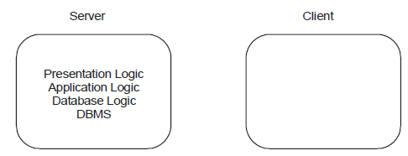
CATEGORIES OF CLIENT/SERVER APPLICATIONS cont’d
Host-based processing: Virtually all the processing is done on a central host, often user interface is via a dumb terminal. It is mainly mainframe environment, not true Client/Server computing. In such a processing’s workstations have very limited role as shown in Fig. 5.1 given below:

Slide 23
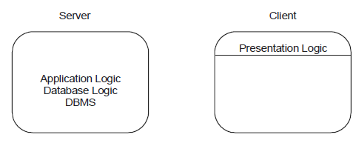
SERVICE OF A CLIENT/SERVER APPLICATION cont’d
Server-based processing: All the processing is done on the server, and server is responsible for providing graphical user interface. A considerable fraction of the load is on the server, so this is also called fat server model shown in Fig. 5.2 given below:

Slide 24
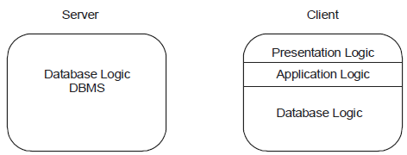
SERVICE OF A CLIENT/SERVER APPLICATION cont’d
Client-based processing: Virtually all application processing may be done at the client, with the exception of data validation routines and other database logic functions that are best performed at the server. Some of the sophisticated database logic functions residing on the client side. This architecture is the most common Client/Server approach in current use. It enables the user to employ applications tailored to local need shown in Fig 5.3 given below:

Slide 25
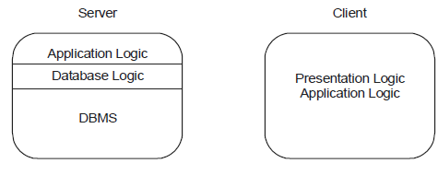
SERVICE OF A CLIENT/SERVER APPLICATION cont’d
Cooperative processing: Taking the advantage of the strengths of both client and server machine and of the distribution of data, the application processing is performed in an optimized fashion. Such a configuration of Client/Server approach is more complex to set up and maintain. But in the long run, this configuration may offer greater user productivity gain and greater network efficiency than others Client/Server approaches. A considerable fraction of the load is on the client, so this is also called fat client model. In case of some application development tools this model is very popular shown in Fig. 5.4 given below:

Slide 26
CLIENT SERVICES
Any workstation that is used by a single user is a client, it has been noticed during last
decade the workstations are improving their performance surprisingly. Having same cost
you can purchase CPU that can perform more than 50 times, main memory approximately 30 times and Hard Disk up to 40 times. These are considered as power factor of computer, hence, as a result, more sophisticated applications can be run from the workstations. To run various applications workstation uses the available operating systems like DOS, Windows (98, 2000, NT) and UNIX or Linux, Mac, OS/2. In case of, network environment (LAN, WAN) workstations also avails the services provided by the network operating systems. Client workstations request services from the attached server. Whether this server is in fact the same processor or a network processor, the application format of the request is the same

Slide 27
CLIENT SERVICES cont’d
Network operating system translates or adds the specifics required by the targeted
requester to the application request. Communication between all these running processes
are better described by Inter Process Communication (IPC), these processes might be on
the same computer, across the LAN, or WAN.
Some of the main services that client performs (role of client) are listed below:
• Responsible for managing the user interface.
• Provides presentation services.
• Accepts and checks the syntax of user inputs. User input and final output, if any,
are presented at the client workstation.
• Acts as a consumer of services provided by one or more server processors.
• Processes application logic.

Slide 28
CLIENT SERVICES cont’d
The role of the client process can be further extended at the client by adding logic that is not implemented in the host server application. Local editing, automatic data entry, help capabilities, and other logic processes can be added in front of the existing host server application.
• Generates database request and transmits to server.
• Passes response back to server.
But in client server model one thing is very obvious that the services are provided by combination of resources using both the client workstation processor and the server processor. For an example, let us take very common example of client server application, a database server provides data in response to an SQL request issued by the workstation application. Local processing by the workstation might calculate the invoice amount and format the response to the workstation screen. Now, it is important to understand that a workstation can operate as a client in some instances while acting as a server in other instances.

Slide 29
CLIENT SERVICES cont’d
For example, in a LAN Manager environment, a workstation might act as a client for one user while simultaneously acting as a print server for many users. In other words we can say “the client workstation can be both client and server when all information and logic pertinent to a request is resident and operates within the client workstation.” Apart from these services discussed above some of the other important services that are directly or indirectly attached with the client services are given below:
(a) Inter process communication.
(b) Remote services.
(c) Window services.

Slide 30
CLIENT SERVICES cont’d
Dynamic data exchange.
(e) Object linking and embedding.
(f) Common object request broker architecture (CORBA).
(g) Print/Fax services.
(h) Database services.

Slide 31
SERVER SERVICES
The server is responsible for controlling and providing shared access to available server resources. Remote workgroups have needed to share these resources when they are connected with server station through a well-managed network. The applications on a server must be isolated from each other so that an error in one application cannot damage another application. Furthermore, the server is responsible for managing the server requester interface so that an individual client request response is synchronized and directed back only to the client requester. This implies both security when authorizing access to a service and integrity of the response to the request

Slide 32
SERVER SERVICES cont’d
For a Client/Server applications servers performs well when they are configured with an operating system that supports shared memory, application isolation, and preemptive multitasking (an operating system with preemptive multitasking enables a higher priority task to preempt or take control of the processor from a currently executing, lower priority task). These preemptive multitasking ensures that no single task can take overall the resources of the server and prevent other tasks from providing service. There must be a means of defining the relative priority of the tasks on the server. These are specific requirements to the Client/Server implementation.

Slide 33
SERVER SERVICES cont’d
One of the prime server characteristic is that it must support for multiple simultaneous client request for service. So that, the server must provide shared memory services and multitasking support. In that respect, the following server platform provides best processors for client server implementation are IBM System/370, DEC VAX , Intel and RISC (Reduced Instruction Set Computers like Sun SPARC, IBM/Motorola PowerPC, HP PA RISC, SGI MIPS, and DEC Alpha). Some of the main operations that server perform are listed below:
• Accepts and processes database requests from client.
• Checks authorization.
• Ensure that integrity constraints are not violated.
• Performs query/update processing and transmits response to client.
• Maintains system catalog.
• Provide concurrent database access.
• Provides recovery control.

Slide 34
SERVER SERVICES cont’d
Apart from these services discussed above some of the other important services that are directly or indirectly attached with the server services in a network operating system environment are given below:
(i) Application services.
(ii) File services.
(iii) Database services.
(iv) Print/fax/image services.
(v) Communications services.
(vi) Security systems services.
(vii) Network management services.
(viii) Server operating system services.

Slide 35
SERVER SERVICES cont’d
Application services:
Application servers provide business services to support the operation of the client workstation. In the Client/Server model these services can be provided for entire partial business functions that are invoked by IPC (Inter Process Communication) or RPCs request for service. A collection of application servers may work in concert to provide an entire business function. For an example, in a inventory control system the stock information may be managed by one application server, sales information are maintained by another application server, and purchase information are maintained by a third application server. On larger and more complicated systems, server responsibility may be distributed among several different types of servers. All these servers are running at different operating systems on various hardware platforms and may use different database servers. The client application invokes these services without consideration of the technology or geographic location of the various servers.

Slide 36
SERVER SERVICES cont’d
File services: A file server can store any type of data, and so on simpler systems, may be the only server necessary. Space for storage is allocated, and free space is managed by the file server. Catalog functions are also provided by the file server to support file naming and directory structure. File services are responsible to handle access to the virtual directories and files located on the client workstation and to the server’s permanent storage. Redirection software provides these services which are installed as part of client workstation operating system. Finally, all clients’ workstation requests are mapped into the virtual pool of resources and redirected as necessary to the appropriate local or remote server.

Slide 37
SERVER SERVICES cont’d
The file services provide this support at the remote server processor. File server manages databases, software’s, shared data, and backups that are stored on tape, disk, and optical storage devices. In order to minimize the installation and maintenance effort of software, software should be loaded directly from the server for execution on the client workstations. New versions of any application software can be updated on the server and made immediately available to all users.

Slide 38
SERVER SERVICES cont’d
Database services: Early database servers were actually file servers with a different interface. Products such as dBASE, Clipper, FoxPro, and Paradox execute the database engine primarily on the client machine and use the file services provided by the file server for record access and free space management. These are new and more powerful implementations of the original flat-file models with extracted indexes for direct record access. Currency control is managed by the application program, which issues lock requests and lock checks, and by the database server, which creates a lock table that is interrogated whenever a record access lock check is generated.

Slide 39
SERVER SERVICES cont’d
Because access is at the record level, all records satisfying the primary key must be returned to the client workstation for filtering. There are no facilities to execute procedural code at the server, to execute joins, or to filter rows prior to returning them to the workstation. This lack of capability dramatically increases the likelihood of records being locked when several clients are accessing the same database and increases network traffic when many unnecessary rows are returned to the workstation only to be rejected. The lack of server execution logic prevents these products from providing automatic partial update backout and recovery after an application, system, or hardware failure. For this reason, systems that operate in this environment require an experienced system support programmer to assist in the recovery after a failure. When the applications are very straight forward and require only a single row to be updated in each interaction, this recovery issue does not arise. However, many Client/Server applications are required to update more than a single row as part of one logical unit of work.

Slide 40
SERVER SERVICES cont’d
Client/Server database engines such as Sybase, IBM’s Database Manager, Ingres, Oracle, and Informix provide support at the server to execute SQL requests issued from the client
workstation. The file services are still used for space allocation and basic directory services, but all other services are provided directly by the database server. Relational database management systems are the current technology for data management. Figure 4.1 charts the evolution of database technology from the first computers in the late 1950s to the object-oriented database technologies that are becoming prevalent in the mid-1990s

Slide 41
SERVER SERVICES cont’d
The following DBMS features must be included in the database engine:
• Performance optimization tools.
• Dynamic transaction backout.
• Roll back from, roll forward to last backup.
• Audit file recovery.
• Automatic error detection and recovery.
• File reclamation and repair tools.
• Support for mirrored databases.
• Capability to split database between physical disk drives.
• Remote distributed database management features.
• Maintenance of accurate and duplicate audit files on any LAN node.

Slide 42
SERVER SERVICES cont’d
In the Client/Server implementation, database processing should offload to the server. Therefore, the database engine should accept SQL requests from the client and execute them totally on the server, returning only the answer set to the client requestor. The database engine should provide support for stored procedures or triggers that run on the server. The Client/Server model implies that there will be multiple concurrent user access. The database engine must be able to manage this access without requiring every developer to write well-behaved applications. The following features must be part of the database engine:
• Locking mechanisms to guarantee data integrity.
• Deadlock detection and prevention.
• Multithreaded application processing
• User access to multiple databases on multiple servers.

Slide 43
SERVER SERVICES cont’d
Print/fax/image services: High-quality printers, workstation-generated faxes, and plotters are natural candidates for support from a shared server. The server can accept input from many clients, queue it according to the priority of the request and handle it when the device is available. Many organizations realize substantial savings by enabling users to generate fax output from their workstations and queue it at a fax server for transmission when the communication costs are lower. Incoming faxes can be queued at the server and transmitted to the appropriate client either on receipt or on request. In concert with workflow management techniques, images can be captured and distributed to the appropriate client

Slide 44
SERVER SERVICES cont’d
workstation from the image server. In the Client/Server model, work queues are maintained at the server by a supervisor in concert with default algorithms that determine how to distribute the queued work. Incoming paper mail can be converted to image form in the mail room and sent to the appropriate client through the LAN rather than through interoffice mail. Centralized capture and distribution enable images to be centrally indexed. This index can be maintained by the database services for all authorized users to query. In this way, images are captured once and are available for distribution immediately to all authorized users. Well-defined standards for electronic document management will allow this technology to become fully integrated into the desktop work environment. There are dramatic opportunities for cost savings and improvements in efficiency, if this technology is properly implemented and used. Chapter 9 discusses in more detail the issues of electronic document management.

Slide 45
SERVER SERVICES cont’d
Communications services:
Client/server applications require LAN and WAN communication services. Basic LAN services are integral to the NOS. WAN services are provided by various communications server products. Chapter 5 provides a complete discussion of connectivity issues in the Client/Server model.
(vi) Security systems services:
Client/server applications require similar security services to those provided by host environments. Every user should be required to log in with a user ID and password. If passwords might become visible to unauthorized users, the security server should insist that passwords be changed regularly. The enterprise on the desk implies that a single logon ID and logon sequence is used to gain the authority once to access all information and process for the user has a need and right of access. Because data may be stored in a less physically secure area, the option should exist to store data in an encrypted form.

Slide 46
SERVER SERVICES cont’d
A combination of the user ID and password should be required to decrypt the data. New options, such as floppy less workstation with integrated Data Encryption Standard (DES) coprocessors, are available from vendors such as Beaver Computer Company. These products automatically encrypt or decrypt data written or read to disk or a communication line. The encryption and decryption are done using the DES algorithm and the user password. This ensures that no unauthorized user can access stored data or communications data. This type of security is particularly useful for laptop computers participating in Client/Server applications, because laptops do not operate in surroundings with the same physical security of an office. To be able to access the system from a laptop without properly utilizing an ID number and password would be courting disaster.

Slide 47
CLIENT/SERVER APPLICATION: CONNECTIVITY cont’d
The communication middleware software provides the means through which clients and servers communicate to perform specific actions. It also provides specialized services to the client process that insulate the front-end applications programmer from the internal working of the database server and network protocols. In the past, applications programmers had to write code that would directly interface with specific database language (generally a version of SQL) and the specific network protocol used by the database server. For example, when writing a front-end application to access an IBM OS/2 database manager database, the programmer had to write SQL and Net BIOS (Network Protocol) command in the application. The Net BIOS command would allow the client process to establish a session with the database server, send specific control information, send the request, and so on.

Slide 48
CLIENT/SERVER APPLICATION: CONNECTIVITY cont’d
If the same application is to be use with a different database and network, the application’s routines must be rewritten for the new database and network protocols. Clearly such a condition is undesirable, and this is where middleware comes in handy. Here definition of middleware is based on the intended goals and main functions of this new software category. In chapter three communication middleware is also discussed, further role and mechanism of middleware is discussed in this section.
Role and Mechanism of Middleware
Role of middleware component can be exactly understand by the way in which Client/Server computing being used , we know that there are number of approaches are there like host-based processing, server based processing, cooperative processing and client based processing. And all these depend on application functionality being used in Client/Server architecture. A Middleware component resides on both Client/Server machine enabling an application or user at a client to access a variety of services provided by server. In other words, we can say middleware provides basis for logical view of Client/Server architecture. Morever, middleware enables the realization of the promises of distributed Client/Server computing concepts.

Slide 49
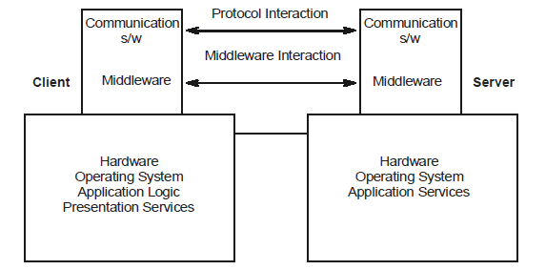
CLIENT/SERVER APPLICATION: CONNECTIVITY
See the Fig. 5.12 (a) and (b) that depicts the role and logical view of middleware in Client/Server architecture. The entire system of the architecture represents a view of a set of applications and resources available to clients. Any client need not be concerned with the location of data or indeed the location of the application.
Middleware Role in Client/Server Architecture

Slide 50
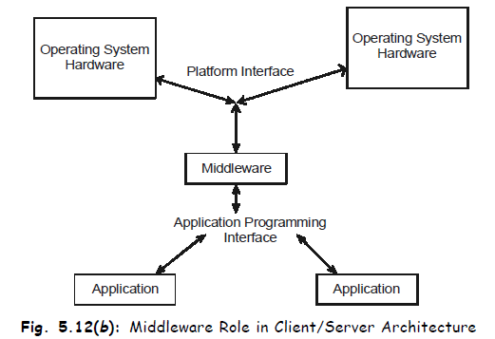
CLIENT/SERVER APPLICATION: CONNECTIVITY cont’d

Slide 51
CLIENT/SERVER APPLICATION: CONNECTIVITY cont’d
All applications operate over a uniform application programming interface. The middleware is responsible for routing client requests to the appropriate server. Also middleware used to overcome operating system as well as network incompatibility. This middleware running on each network component ensures that all network users have transparent access to applications and resources of any networks.

Slide 52
CLIENT/SERVER APPLICATION: LAYERED ARCHITECTURE
An essential factor in the success of a client/server environment is the way in which the
user interacts with the system as a whole. Thus the design of the user interface to the
client machine is critical. In most client/server systems, there is heavy emphasis on providing
a graphical user interface that is easy to use, easy to learn, yet powerful and flexible. Section
follow covers the design issues of client/server architecture. And also designing issues
associated with layered application architecture with their interfaces in the three-layered
application architecture.

Slide 53
CLIENT/SERVER APPLICATION: LAYERED ARCHITECTURE cont’d
Design Approach
In client/server architecture as a design approach, the functional components of an application are partitioned in a manner that allows them to be spread and executed across different computing platforms, and share access to one or more common repositories. Client/server architecture is therefore a design approach that distributes the functional processing of an application across two or more different processing platforms. The phrase ‘client/server’ reflects the role played by an application’s functions as they interact with one another. One or more of these functions is to provide a service, typically in the form of a database server that is commonly used by other functions across the application(s). In this regard, it is important to discuss the concept of ‘layered application architecture’ .

Slide 54
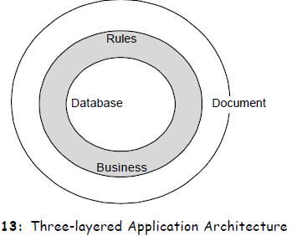
CLIENT/SERVER APPLICATION: LAYERED ARCHITECTURE cont’d
Application design architecture plays a crucial role in aiding development of robust applications. Figure. 5.13 given below shows the three layers of any fairly large business application. The most detailed layer is the database layer, the centre of an application. The next higher layer is the business rule layer. Finally, the highest level of abstraction is the document layer. This is the layer visible to users of the application.

Slide 55
CLIENT/SERVER APPLICATION: LAYERED ARCHITECTURE cont’d
Designing a client/server application offers challenges not normally faced by developers of mainframe-oriented multiuser applications. To realize full benefits of client/server architecture, developers need to incorporate a greater potential for functionality and data distribution in the fundamental design of their applications. A client/server application operates across multiple platforms, i.e. a server platform for the database, and a client platform for the application. At this minimum level of utilization, the design of client/server does not differ much from its mainframe counterpart, and the physical issues faced by developers on both the platforms are primarily those of packaging. But to take full advantage of client/server paradigm, developers need to address issues of functional distribution for their applications, not just across client and server platform but also across all nodes of the network. Issues surrounding functional distribution constitute the single biggest difference between physical designs of multiuser and client/server application.

Slide 56
CLIENT/SERVER APPLICATION: LAYERED ARCHITECTURE cont’d
Interface in Three Layers
The key to use a three-layered application architecture is to understand the interfaces used in all its three layers. Figure 5.14 illustrates these interfaces. They are:
• Graphical user interface.
• Process request interface.
• Transaction and query manager interface.
An interface enables a component in one layer to communicate with a component in another layer; it also enables a component to interact with another component in the same layer. In Fig. 5.14 communication between components in the same layer is indicated by a semicircular arrow. Moreover, we can say that this describes a collection of mutually cooperating components that make request to each other, both within and across layers, with its components working together thus, and processing various requests—wherever they comes from; a business application comes to life.

Slide 57
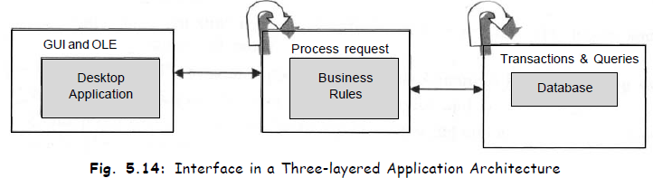
CLIENT/SERVER APPLICATION: LAYERED ARCHITECTURE cont’d
Cooperating components in a layered application design provide the following:
• A framework for building highly flexible applications that can be changed easily to meet the changing needs of business.
• A high level of software reuse.
• Easier development of large, complex applications that can sustain high throughput levels in both decision support and transaction environments.
• Easier development of distributed applications that support centrally and self-managed teams.

Slide 58
The end.
Q & A

